Slide 1
VFD and HMI Programming

Slide 2
What is a VFD?
VFD stands for Variable Frequency Drive. As its name suggests it is an adjustable frequency drive that varies the frequency of the AC supply. Since the speed of an induction motor depends on the supply frequency, the VFD can be used to vary its speed.
A VFD is a power converter that uses electronic circuits to convert a fixed frequency and fixed voltage into a variable frequency and variable voltage. It even enables a motor to run above its rated speed by increasing the frequency. Due to its programmable and easy to use UI (user interface), it can be easily used to monitor and maintain the speed of an electrical motor.

Slide 3
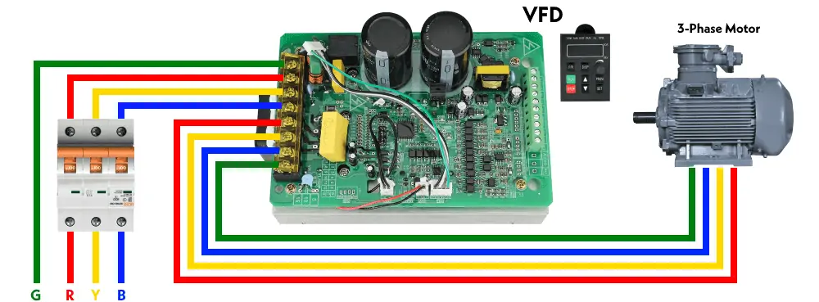

Slide 4
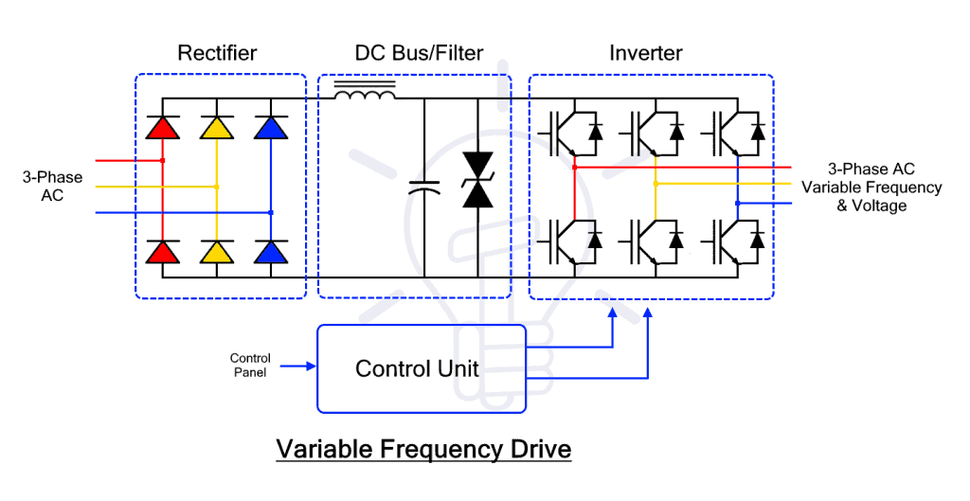
Circuit Diagram of VFD
The main function of a VFD is to vary the operating frequency of an AC supply. Simply put it converts the AC into DC and then into AC having adjustable frequency, but the operation uses four blocks or sections of VFD.

Slide 5
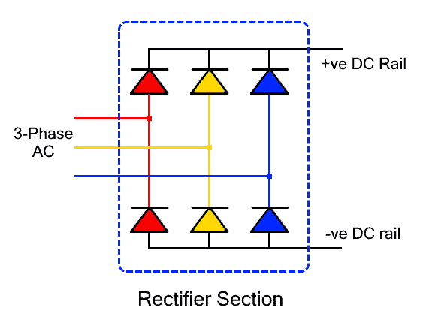
The Rectifier
The input AC supply is connected to the Rectifier section of the VFD. It is a full-wave rectifier that converts the AC power into unfiltered DC.
It is made of 6 or 4 diodes or thyristors. Six diodes are used for three-phase power conversion while 4 diodes in bridge configuration are used for single-phase AC power conversion. Whereas the diode rectifier is used for uncontrolled conversion while the thyristor offers controlled switching that varies the output DC power.

Slide 6
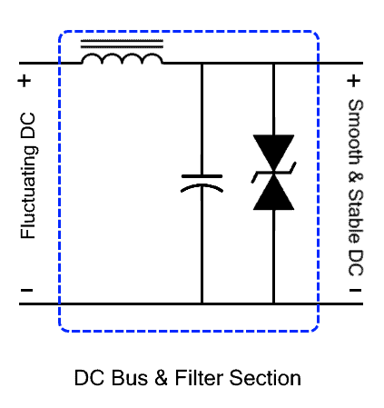
DC Bus and Filter
This intermediate section is used for filtering and storing the DC power that is retrieved by the inverter. Its main function of filters is to remove the ripples from the pulsating DC output of the rectifier.
It is mainly made of capacitors to filter the ripples from the pulsating DC and also store it. It may include an inductor as well depending on the type of ripples.

Slide 7
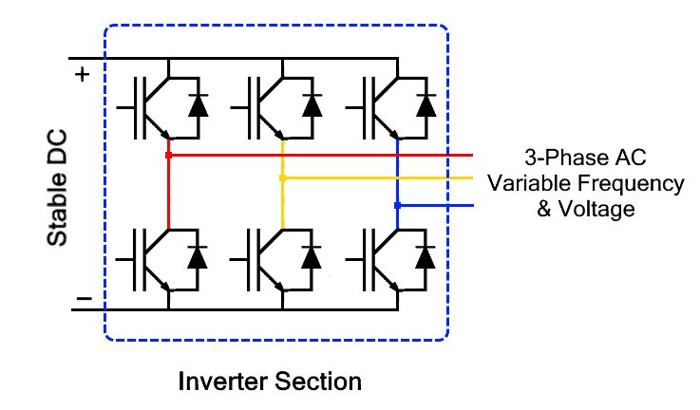
Inverter
This is the inverter or switching section that converts the steady DC into alternating AC with adjustable frequency.
It is made of power transistors or IGBTs. They switch rapidly to provide alternating voltage at the output. Its switching frequency determines the output AC frequency. Where as, the switching rate of IGBTs is controlled through the control unit.
There are 4 IGBTs used for single-phase conversion while 6 IGBTs are used for three-phase power conversion.

Slide 8
Control Unit
This section is the controlling unit responsible for controlling the switching operation, output frequency, output power. It is integrated with the user interface and sensors to acquire the necessary data. It also monitors fault conditions.
The control unit consists of an embedded microprocessor programmed for controlling the rectifier and inverter section. It can react in microseconds in case of any fault conditions. The feedback data from the speed sensor is used to monitor the speed as well as adjust it accordingly to the need.

Slide 9
Types of VFDs
There are three types of VFD classified based on the method of power conversion.
VSI type VFDs
CSI type VFDs
PWM type VFD

Slide 10
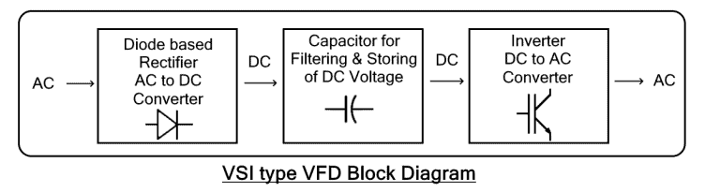
VSI type VFDs
The VSI or Voltage Source Inverter type VFD is the most common type. it provides a smooth voltage waveform that depends on the output frequency. It has a very simple design including a simple diode rectifier with a capacitor for filtering and storing DC energy. The DC voltage is then converted into AC using an inverter. They offer very good operating speed and control multiple motors.
The drawback of VSI is that they have poor power factors as well as they cause motor cogging at a low frequency below 6 Hz. Apart from that, they are also non-regenerative i.e. they cannot store the energy flowing back from the motor.

Slide 11
Advantages
Disadvantages
It has a very simple design.
It is very cheaper and cost-effective.
It offers a very good operating speed range
It can control multiple motors.
It has a very poor power factor, especially at low speed.
It causes the motor to cog below 6Hz frequency.
The cogging causes the motor to jerk at starting and stopping.
Different harmonics are generated at its output.
They are non-regenerative.

Slide 12
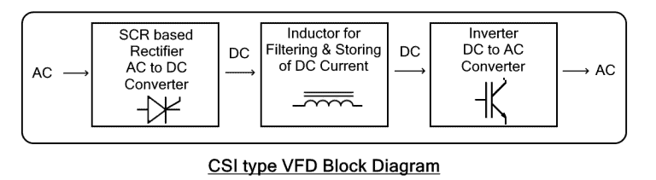
CSI type VFDs
CSI or Current Source Inverter type VFD provides a smooth current waveform as opposed to the smooth voltage waveform of the VSI type. It utilizes large inductors and expensive inductors to store and deliver steady DC current.
The drawback of VSI is that they have poor power factors as well as they cause motor cogging at a low frequency below 6 Hz. Apart from that, they are also non-regenerative i.e. they cannot store the energy flowing back from the motor.

Slide 13
Advantages
Disadvantages
It has regenerative capabilities to absorb the power coming back from the motor.
It acts as a constant current source that supports high-power motors.
It has a very simple design.
It is more reliable than VSI type VFD.
It has a poor power factor, especially at low speed.
The inductors are very large and expensive.
Overall CSI VFD is expensive than VSI VFD.
It causes cogging effect creates jerks in the motor shaft during starting and stopping.
Unlike the VSI type, it cannot run multiple motors at once.

Slide 14
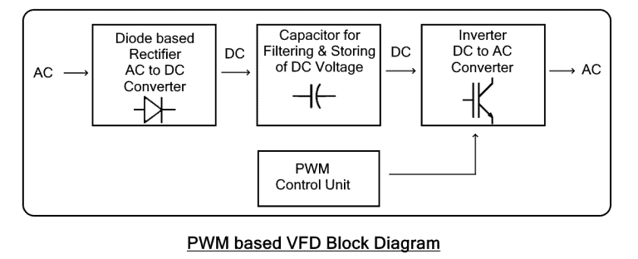
PWM type VFD
PWM or Pulse Width Modulation is a technique where the duty cycle of a signal is varied to vary the average power delivered. PWM-based VFD uses fixed DC voltage pulses of different duty cycles to simulate a sinusoidal waveform. It is an improved version of VSI, therefore, it provides stable voltage with an improved power factor.
It has a simple diode bridge rectifier that converts AC into DC. The Control Unit is programmed to control the duty cycle of the inverted output by adjusting the switching speed of the inverter. It also requires an extra regulator at its output to regulate the voltage pulses and provide a smooth voltage and current waveform. It is the most common method used in VFDs due to its numerous advantages over the VSI and CSI VFD.

Slide 15
Advantages
Disadvantages
It has an improved power factor.
It does not cause cogging in motors.
It has much better efficiency than VSI and CSI.
It has a complex design and implementation.
It requires an additional hardware circuit, regulator.
It is expensive than VSI and CSI.

Slide 16
Advantages of VFD
Improved Efficiency: The conventional speed control using the variable voltage method wastes a lot of energy as compared to the variable frequency method. Therefore, VFD is used in industries to increase motor efficiency and conserve a great amount of energy.
Precise Control: A VFD allows tighter control of the speed using a sensor to run the motor at an efficient speed that does not cause hindrance and increases the production speed in the industries.
Limits Inrush Current: Inrush current is the huge starting current drawn by an induction motor during its startup. it is 5 to 8 times greater than its rated current. It can damage the windings of the motor. The VFD can safely limit the starting current and it is used in one of the methods for induction motor starting.

Slide 17
Extend Mechanical Life: It can safely start and stop a motor with a gradual change in speed without any mechanical jerks. It extends the mechanical life of the motor.
Reduced Maintenance: Smooth operation of motors reduces the mechanical stress and eliminates the jerks that eventually reduce the maintenance required for such motor. Thus reducing the long-term cost.
Power Factor: A poor power factor causes reactive power loss that is the energy wasted in the form of heat. Induction motor usually has a low power factor. A VFD improves the power factor to utilize the power more efficiently.

Slide 18
Protection: A VFD can also provide protection against overload, over-voltage and phase loss. It immediately stops the supply current in case of such faults to protect the load connected from damage.
Easy installation: They are easier to install and operate since they are programmed during manufacturing with easy to operate and friendly user interface.

Slide 19
Disadvantages of VFD
Initial Cost: VFDs are expensive than direct on-line or across the line motor starter. Therefore, the initial cost for the installation of VFDs in a large factory is fairly high.
Special Motor Design: The PWM-based AC output of VFD is not pure sinusoid. It can create stress in the windings of a normal AC motor that can heat up and degrade the winding insulation. Therefore, a special motor with improved insulation design rated for PWM inverter is required for running with VFD.
Harmonics: The VFD can create harmonic in the supply. The non-linear current draw of the rectifier circuit creates distortion in the supply that affects the electrical equipment connected in parallel. Therefore, it requires extra harmonic filters.

Slide 20
Complex Operation: As compared to direct on-line DOL or across the line starter, the operation and settings of VFD is complex. Modern VFDs have a more user-friendly interface, but still, it cannot compete with the direct on-line starter simple push-button operation.
Extreme Environment: As compared to the DOL starter, the electronic circuitry in VFD is sensitive and its operation is affected by extreme cold or heat. It requires additional measures to cope with such an extreme environment.

Slide 21
Application of VFD
Here are some applications of VFD.
The variable-frequency feature is used for controlling the speed of induction motor whose speed only depends on frequency.
It is used for precise motor speed control with smooth starting and stopping in conveyor belt systems to avoid any accidents and have increased production.
The precise speed control is also used in the cooling system to maintain temperature.
Lifts and escalators use the smooth start and stop feature of VFD.
They are used for water pumps and also for crushers in mining.
Hoist and crane use VFD for precise control of speed and positioning.

Slide 22
Why Use an Inverter?
Energy savings
Smooth acceleration and deceleration
Reduced mechanical stress
Speed control
Process optimization
Soft start capability

Slide 23
Inverter Selection
Motor-Based Selection
Load-Based Selection
Environmental Considerations
Overload Capacity

Slide 24
Motor-Based Selection
Select inverter based on:
Motor Rated Power (kW/HP)
Rated Current (Primary selection criterion)
Voltage rating
Frequency rating
Number of phases
Load-Based Selection
Load Types:
Constant Torque Load
Conveyor
Compressor
Extruder
Variable Torque Load
Fan
Pump
Blower
Constant Power Load
Winder
CNC spindle

Slide 25
Environmental Considerations
Ambient temperature
Altitude
Dust/moisture (IP rating)
Enclosure type (IP20, IP54, etc.)
Cooling method
Overload Capacity
Typical ratings:
150% for 60 seconds (Normal duty)
200% for 3 seconds (Heavy duty)

Slide 26
Selection of Peripheral Devices
Input Side Devices
MCB/MCCB
Short circuit protection.
Contactor
Isolation.
Line Reactor
Reduces harmonics.
EMI Filter
Reduces electromagnetic interference.
Output Side Devices
Output Reactor
Reduces dv/dt stress.
Braking Resistor
Dissipates regenerative energy.
Dynamic Braking Unit
Motor Protection Relay

Slide 27
Control Side Devices
Push buttons
Selector switches
Potentiometer (Speed control)
PLC
HMI
Encoder (for feedback control)

Slide 28
Motor Types Used with Inverters
Induction Motor (Most Common)
Squirrel cage motor
Robust and economical
Suitable for scalar control (V/f)
Permanent Magnet Synchronous Motor (PMSM)
High efficiency
Used in servo systems
Requires vector control

Slide 29
Synchronous Motor
Precise speed control
Power factor correction capability
Special Motors
Servo motor
Spindle motor
BLDC motor

Slide 30
Power and Signal Connections
Power Connections
Input Terminals:
R, Y, B (3-phase)
L, N (single phase)
Output Terminals:
U, V, W (to motor)
Ground:
Earth terminal mandatory
Control (Signal) Connections
Digital Inputs (DI)
Analog Inputs (AI)
Digital Outputs (DO)
Analog Outputs (AO)
Communication Ports (RS-485, Modbus)

Slide 31
Analog Speed Control Example:
0–10 V → Speed reference
4–20 mA → Industrial control standard

Slide 32
Important Parameters of Inverter
Basic Parameters
Motor rated voltage
Motor rated current
Motor rated frequency
Motor rated speed
Acceleration time
Deceleration time
Maximum frequency
Minimum frequency
Protection Parameters
Overcurrent
Overvoltage
Undervoltage
Overtemperature
Ground fault
Phase loss

Slide 33
Control Parameters
V/f curve
Carrier frequency
Torque boost
PID settings
Slip compensation

Slide 34
Different Types of Load Patterns
Continuous Load
Motor runs continuously.
Example: Conveyor
Intermittent Load
Frequent start/stop.
Example: Lift
Impact Load
Sudden torque variation.
Example: Press machine
Variable Torque Load
Torque proportional to square of speed.
Example: Fan and pump
Constant Power Load
Power constant; torque inversely proportional to speed.
Example: Winder

Slide 35
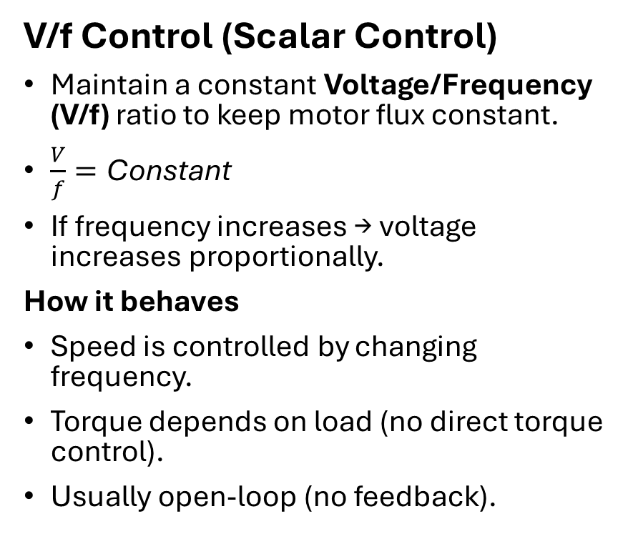
Different Modes of Operation
V/f Control (Scalar Control)
Maintain a constant Voltage/Frequency (V/f) ratio to keep motor flux constant.
$\frac{V}{f}=\text{Constant}$
If frequency increases → voltage increases proportionally.
How it behaves
Speed is controlled by changing frequency.
Torque depends on load (no direct torque control).
Usually open-loop (no feedback).
Simple Example
Ceiling Fan or Water Pump
If you reduce frequency from 50 Hz to 25 Hz:
Speed becomes approximately half.
Voltage is also reduced proportionally.
Motor runs smoothly but torque control is not precise.

Slide 36
Vector Control (Field-Oriented Control)
Separates motor current into:
Flux component (Id)
Torque component (Iq)
Just like a DC motor where:
Field controls flux
Armature controls torque
How it behaves
Torque and flux are controlled independently.
Very fast response.
High torque even at low speed.
Simple Example
Elevator or CNC Machine
If load suddenly increases:
Drive immediately increases torque current (Iq).
Speed remains almost constant.
Very smooth operation.

Slide 37
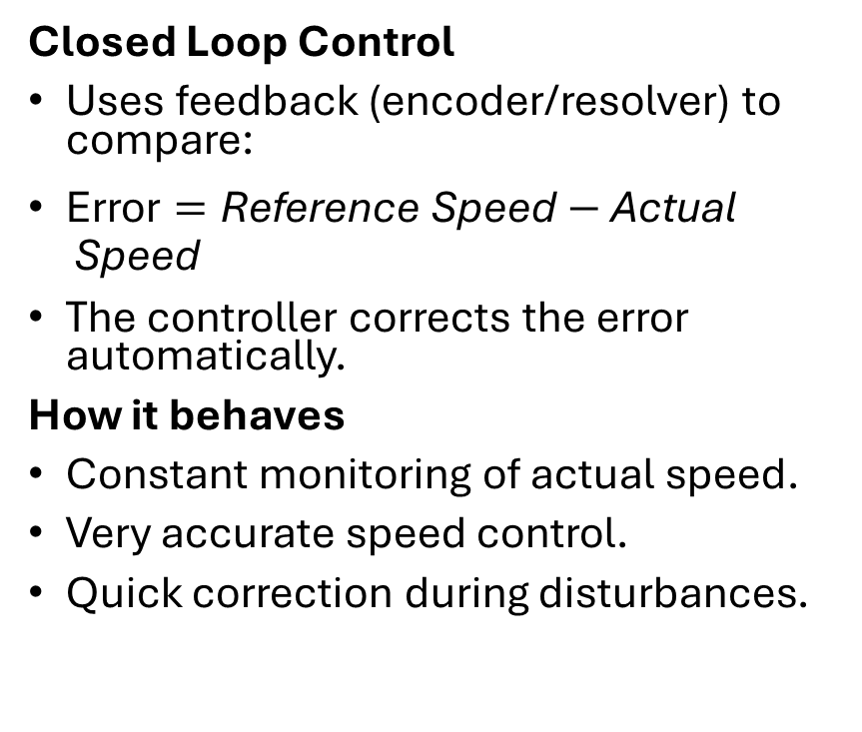
Closed Loop Control
Uses feedback (encoder/resolver) to compare:
$\text{Error}=\text{Reference} \text{Speed}−\text{Actual} \text{Speed}$
The controller corrects the error automatically.
How it behaves
Constant monitoring of actual speed.
Very accurate speed control.
Quick correction during disturbances.
Simple Example
Robotic Arm
If commanded speed = 1000 rpm If actual speed drops to 950 rpm (due to load), → Controller detects error → Increases torque → Speed returns to 1000 rpm

Slide 38
Sensorless Vector Control
Same as vector control but without speed sensor.
Speed is estimated using motor voltage and current models.
How it behaves
No encoder required.
Good performance at medium and high speeds.
Slightly less accurate at very low speed.
Simple Example
Industrial Pump System
Instead of installing an encoder:
Drive calculates speed internally.
Maintains good speed regulation.
Reduces cost and maintenance.

Slide 39
PU, External & Network Mode
PU Mode (Programming Unit Mode)
Control from keypad.
Used for:
Testing
Commissioning
Troubleshooting
External Mode
Controlled via:
Terminal inputs
Analog signals
PLC
Used in industrial automation.

Slide 40
Network Mode
Controlled through communication protocol:
Modbus
Profibus
CAN
Ethernet/IP
Used in Industry 4.0 systems.

Slide 41
JOG Operation
Short duration low-speed operation.
Used for:
Positioning
Alignment
Maintenance
Features:
Fixed low frequency
Operates only while button pressed
Example:
Conveyor belt alignment
Tool positioning

Slide 42
I/O Assignment in Inverter
Digital Input Assignment
Typical functions:
Start
Stop
Forward
Reverse
Reset
JOG
Multi-speed selection
Analog Input Assignment
Speed reference
PID feedback
Torque limit

Slide 43
Digital Output Assignment
Run indication
Fault signal
At speed
Zero speed detection
Analog Output Assignment
Motor speed
Output frequency
Motor current
Torque percentage

Slide 44
Auto-Tuning in VFD (Offline and Online)
Auto-tuning is a feature in a Variable Frequency Drive (VFD) that automatically identifies the electrical parameters of the connected motor and adjusts the control algorithm to ensure accurate speed, torque, and position control.
Motor parameters that are typically identified include:
Stator resistance
Rotor resistance
Inductance
Magnetizing current
Motor inertia
Accurate parameter identification improves control accuracy and efficiency, especially in vector control drives.

Slide 45
Types of Auto-Tuning
Offline Auto-Tuning (Static Auto-Tune)
Online Auto-Tuning (Dynamic Auto-Tune)
Working
The motor does not rotate during tuning.
VFD injects a small test signal into the motor windings.
Electrical parameters are measured.
Features
Safe for systems where motor movement is not allowed.
Faster tuning process.
Example
A conveyor belt system in a packaging plant is connected to a new motor. Before running the system, the engineer performs offline auto-tuning to allow the VFD to learn the motor parameters without rotating the conveyor.
Working
Motor rotates during tuning.
VFD measures dynamic parameters such as inertia and load characteristics.
Features
Provides more accurate tuning.
Used when precise vector control is required.
Example
In a CNC machine spindle, precise torque control is required. Online auto-tuning is performed while the motor rotates to obtain accurate dynamic parameters.

Slide 46
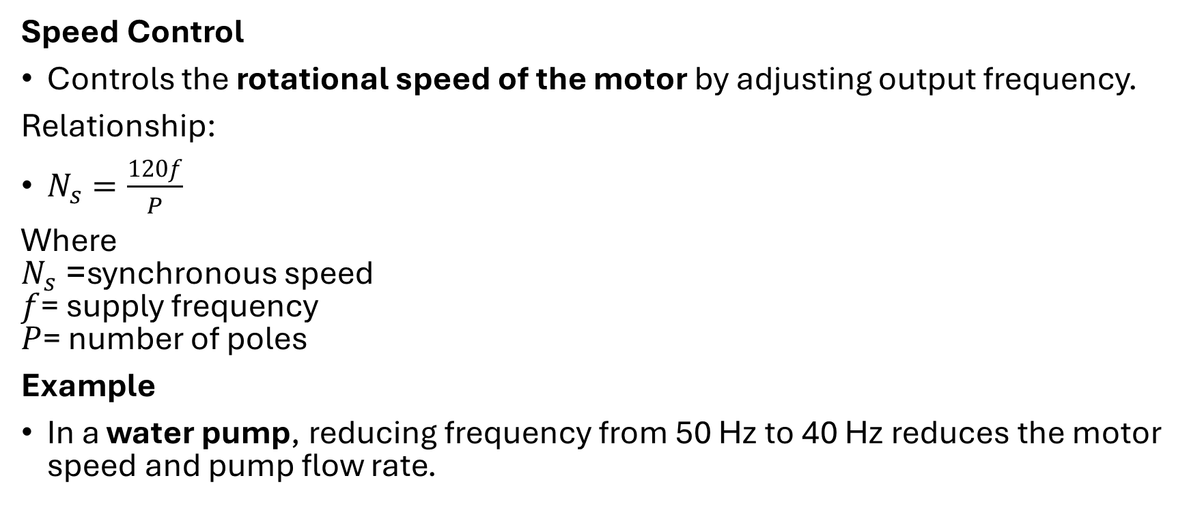
Control Types in VFD
Speed Control
Controls the rotational speed of the motor by adjusting output frequency.
Relationship:
$N_{s}=\frac{120f}{P}$
Where $N_{s}$= synchronous speed $f$= supply frequency $P$= number of poles
Example
In a water pump, reducing frequency from 50 Hz to 40 Hz reduces the motor speed and pump flow rate.

Slide 47
Torque Control
Controls the torque output of the motor independent of speed.
Used in:
Winding machines
Conveyors
Extruders
Example
In a paper winding machine, torque must remain constant while the roll diameter changes.

Slide 48
Position Control
Used when the motor must stop at an exact angular position.
Requires:
Encoder or feedback sensor.
Example
In robotic arms, motors must move to precise angular positions.

Slide 49
Braking Mechanism in a VFD-Driven Motor
In many industrial applications, a motor must stop quickly, safely, and accurately. When a motor is decelerated rapidly, the rotating parts (motor rotor and connected load) still contain stored kinetic energy. If this energy is not controlled, it can cause overvoltage in the VFD, mechanical damage, or unsafe operation. Therefore, a braking mechanism is required.
1. To Stop the Motor Quickly
Some industrial processes require rapid stopping to maintain productivity and safety.
Example: In a conveyor system, when the stop command is given, the motor should stop immediately to prevent product damage or accidents.

Slide 50
2. To Prevent Overvoltage in the VFD
When a motor slows down, it behaves like a generator and sends electrical energy back to the VFD. This energy increases the DC bus voltage in the drive.
If the voltage becomes too high, it may:
Trip the VFD
Damage electronic components
Braking mechanisms help dissipate or redirect this energy.

Slide 51
3. To Improve Process Control
Precise braking helps maintain accurate control of motion.
Example: In robotic systems or CNC machines, motors must stop at exact positions. A braking mechanism ensures controlled deceleration.
4. To Handle High Inertia Loads
Machines with large rotating masses continue to rotate even after the motor power is reduced.
Examples of high inertia loads:
Cranes
Elevators
Rolling mills
Flywheels
Braking systems help reduce stopping time and control these heavy loads safely.

Slide 52
5. To Enhance Safety
Uncontrolled motion can lead to accidents in industrial environments.
Example: In elevators, braking mechanisms ensure the motor stops safely at the correct floor without overshooting.
6. To Improve Energy Efficiency
In regenerative braking systems, the generated energy is returned to the power supply, reducing energy waste.
Example: Electric trains use regenerative braking to send electricity back to the grid.

Slide 53
Braking Features in VFD
When a motor decelerates quickly, it behaves like a generator and sends energy back to the drive. This energy must be dissipated or reused.
Dynamic Braking
Principle
Excess energy is converted into heat through a braking resistor.
A braking chopper circuit connects the resistor to the DC bus.
Working
Motor slows down.
Energy flows back to the VFD.
Chopper circuit activates.
Energy dissipates in braking resistor.
Advantages
Simple and reliable
Cost effective
Example
Used in:
Elevators
Cranes
Conveyor systems
When a crane lowers a load, the motor generates energy which is dissipated in the braking resistor.

Slide 54
Regenerative Braking
Principle
Instead of wasting energy as heat, the energy is fed back to the power supply.
Working
Motor acts as generator.
Energy flows back to DC bus.
Regenerative unit converts it to AC.
Power returned to electrical grid.
Advantages
Energy efficient
Reduces operating cost
Example
Used in:
Electric trains
Elevators
Large industrial drives
When a metro train slows down, the motor generates electricity that is returned to the power grid.

Slide 55
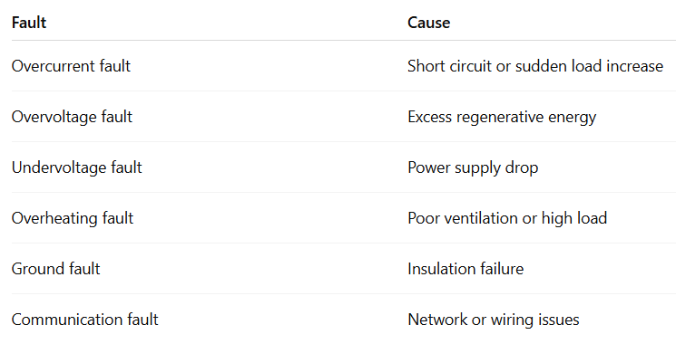
Faults in VFD
VFDs include protection mechanisms to prevent damage to the drive and motor.

Slide 56
Troubleshooting Techniques
Troubleshooting is the systematic process of identifying and correcting faults.
Step-by-Step Troubleshooting
Step 1 – Check Power Supply
Verify:
Input voltage
Phase balance
Proper grounding
Step 2 – Inspect Wiring
Check:
Motor cables
Control wiring
Communication cables

Slide 57
Step 3 – Verify Parameter Settings
Incorrect parameters may cause:
Motor vibration
Speed instability
Examples:
Wrong motor rating
Incorrect acceleration time

Slide 58
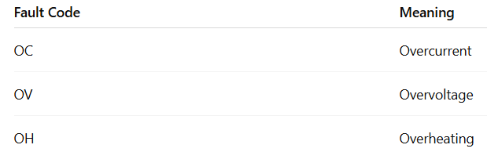
Step 4 – Analyze Fault Codes
VFD displays fault codes.

Slide 59
Step 5 – Check Motor Condition
Verify:
Motor insulation
Bearing condition
Load torque

Slide 60
Apply the concept of V/f control to explain how a VFD maintains constant flux in an induction motor. Illustrate with a neat diagram and discuss its suitability for different load types.
Explain how vector control improves torque response compared to scalar control. Apply the concept of decoupled flux and torque control in an industrial motor application.
Discuss the operational modes of a VFD (PU mode, External mode, Net mode, Jog mode). Explain how each mode is selected and applied in an industrial setup.
Explain the process of auto-tuning (online and offline) in a VFD. Apply this concept to justify its importance in improving motor performance and stability.
Describe the braking methods available in VFDs (Dynamic and Regenerative braking). Explain their working principles and industrial applicability.
Classify different load patterns (constant torque, variable torque, constant power). Apply suitable VFD control modes for each load and justify your selection.

